Slide 1

Student Government Association’s Student Budget Allocation Committee

Slide 2
“The basic premise for funding is that organizations and their activities contribute to the educational, cultural, or recreational well being of all Central Michigan University students”

Slide 3
Committee Makeup
Consists of ten individuals
Members of SGA General Board occupy two seats
SGA Director of Internal Affairs occupies one seat
Members of RSOs occupy five seats
SGA Treasurer occupies one seat
Chairperson (TBA) occupies one seat

Slide 4
What is the SBAC Process?
The SBAC process consists of the steps that an RSO takes to apply for SBAC Funding for either a project, conference, or volunteerism service trip that they would like to attend.

Slide 5
Before applying, ask yourself…
Is my RSO registered on Engage (as well as our SGA Rep)?
Is my RSO in ”good standing” with SGA?
  If not, has my RSO been granted Hardship?

Slide 6
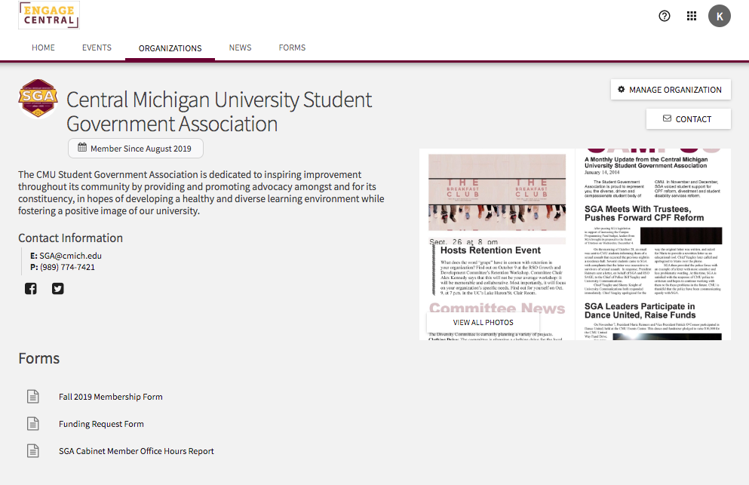
How to Register SGA Rep on Engage

Slide 7
What is “good standing?”
Organizations that send a Representative to the SGA House of Representative meetings each week and join a committee will be considered in good standing with SGA depending on attendance.
If you aren’t in good standing, you can apply for Hardship – application should be on your RSO’s Engage portal under “Forms”
If you are not in ”good standing” or have not applied for/received Hardship, your RSO is ineligible to receive funds – attendance is key!

Slide 8
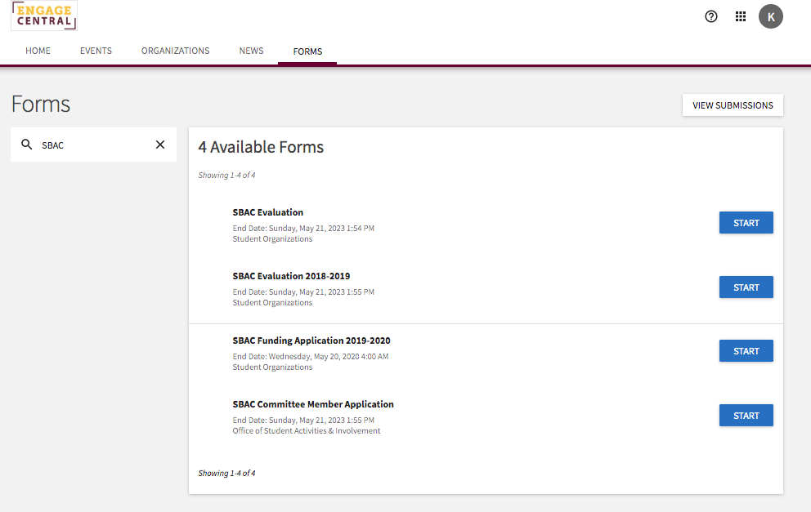
How do I apply for funding?
The SBAC application can be found under the “Forms” tab of your RSO’s Engage portal or on the SBAC website.

Slide 9
What Kinds of “Stuff” Can SBAC Provide Funding For?

Slide 10
Projects
SBAC can fund projects/programs that RSOs want to put on here at CMU
Examples: Movie showings, speakers, cultural food tasters, social issue advocacy events, on campus conferences, etc

Slide 11
Conferences
SBAC can also fund conferences that RSOs choose to participate in
A conference is defined “as any workshop or series program held on or off campus that provides students with an opportunity to bring back valuable information that develops individual students, the representing RSO and all CMU students”

Slide 12
Conference Funding Limitations
Funding for conferences is limited to the following:
  Registration fees
  Accommodations (Hotel Expenses)
  Transportation (Note that personal car travel expenses will NOT be funded by SBAC)

Slide 13
Project/Conference Manual
All projects/conferences/volunteerism trips must meet criteria set out in the Project and Conference manuals
The manuals are documents that set out rules/requirements that projects and conferences must meet
These manuals can be found on the SBAC application!

Slide 14
If You’ve Made it to this Point, go ahead and apply!

Slide 15
Application Makeup
To access the SBAC Funding Application:
Go to the “Forms” tab on your RSO’s Engage Portal

Slide 16
What does it look like?

Slide 17
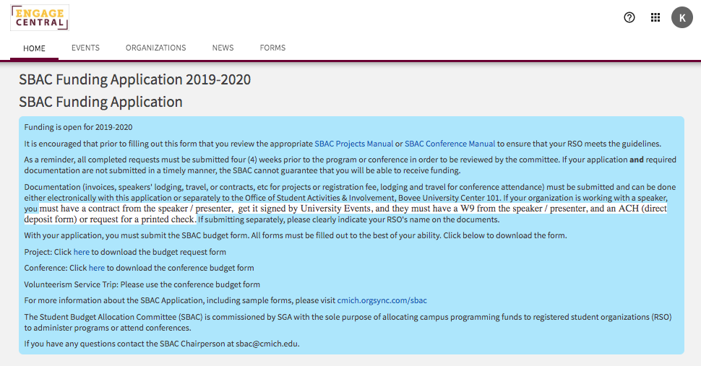

Slide 18
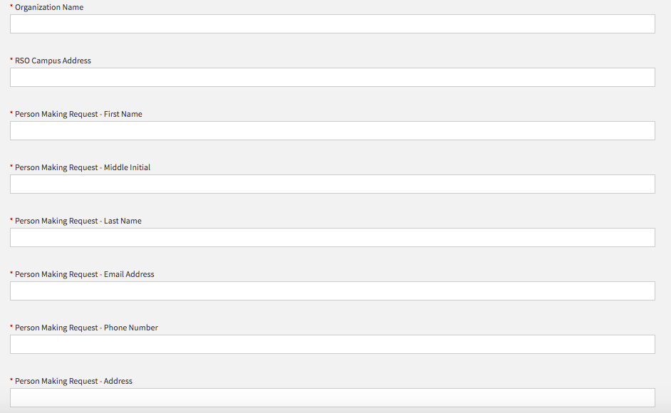

Slide 19
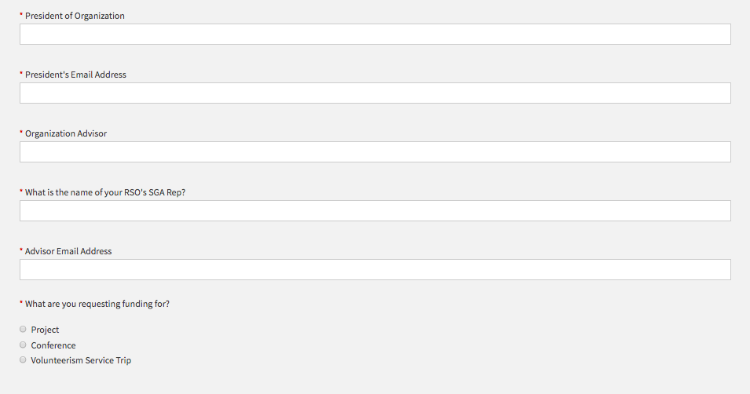

Slide 20
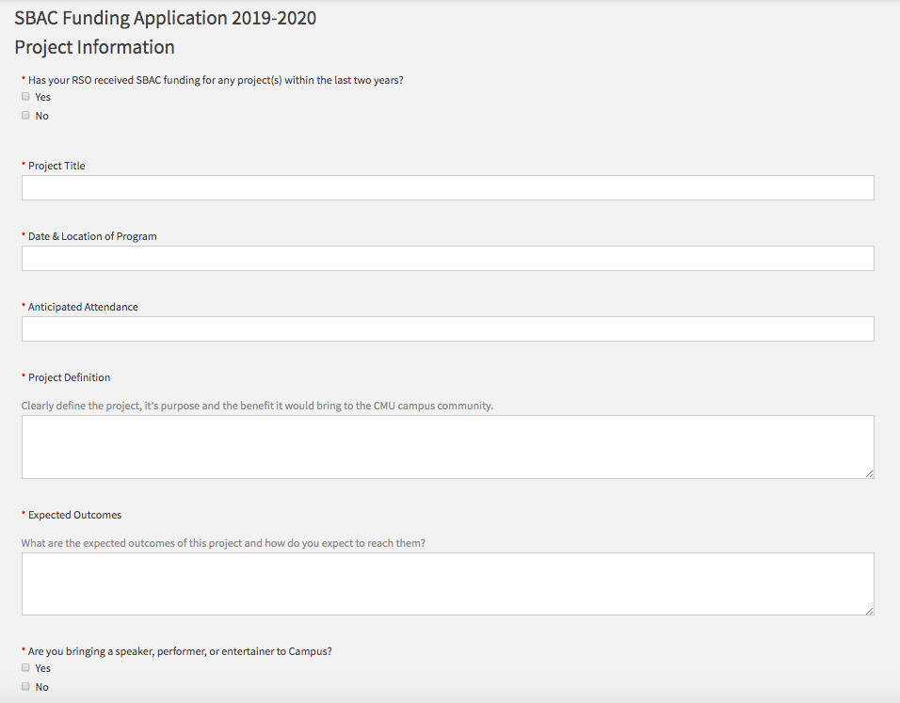

Slide 21
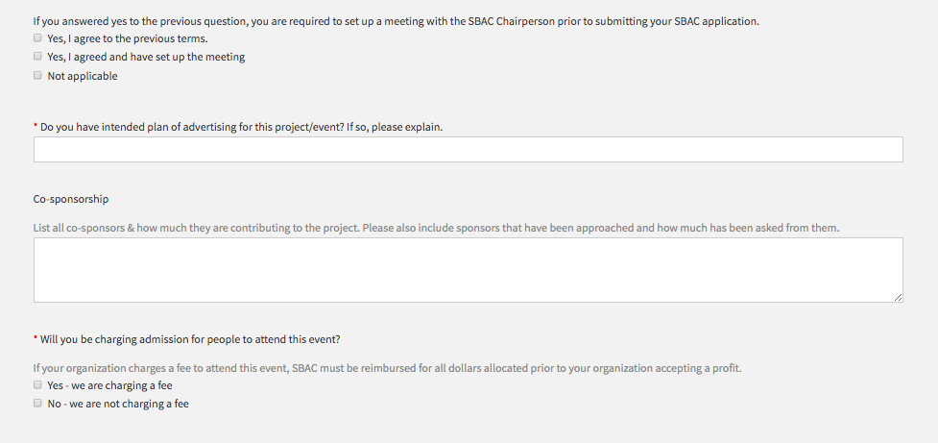

Slide 22
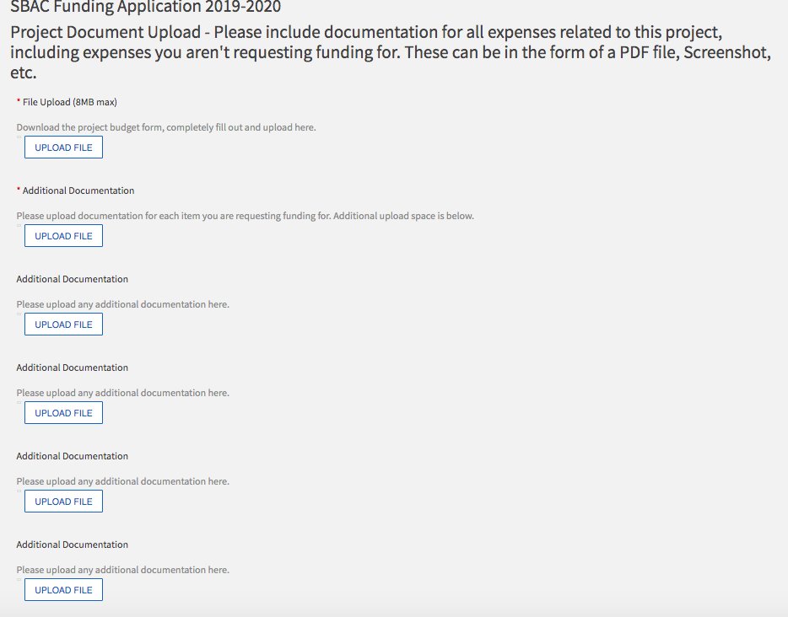
Documentation is key for an SBAC Application!

Slide 23
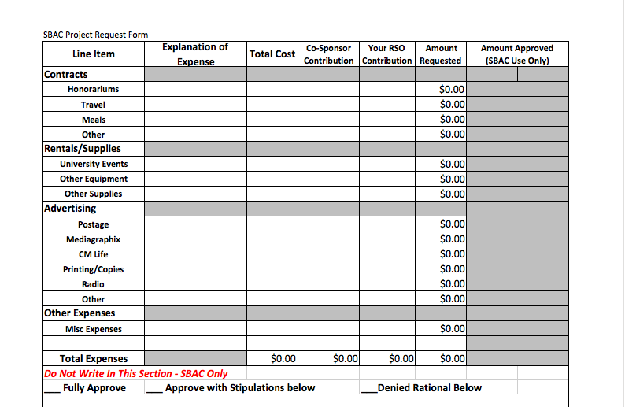
Budget Request Form Example

Slide 24
Important Information
Please review the corresponding guidelines for what kind of funding you are applying for
Apply as soon as possible – minimum of four weeks beforehand
Please be detailed and fill out the application as best as you can

Slide 25
Other Frequent Questions…

Slide 26
How much funding can RSOs receive?
There is no specific amount that any organization can receive but do NOT expect that SBAC will fully fund any project or conference. Allocation decisions are at the discretion of the committee.

Slide 27
How does the actual funding process work?
SBAC operates on a reimbursement basis for conferences and some parts of projects
Honorariums for speakers are typically paid upfront
Reimbursement is almost always deposited to an RSO’s bank account

Slide 28
Answer Questions to the Best of Your Ability!
Come to me with any questions you have!

Slide 29
For All Information…
Go to https://www.cmich.edu/ess/sai/StudentOrganizations/SBAC/Pages/default.aspx
Email me at sbac@cmich.edu
Office Hours – By Appointment

Slide 30
Any Questions/Concerns?

Slide 31
Thank You!

